Slide 1

Child Care Group Enrollment Management Service
CSCE 606 - 600
Chidambaram Ganesan
Daehee Han
Tanmai Harish
Noah Pang
Atharva Hemant Phand
Bharath Kumar Ravichandran
Notes:
Hello, my name is Daehee Han from Child Care Group team, and I will be presenting cumulation of our collective efforts - Child Care Group Enrollment Management Service application.

Slide 2
Child Care Group Enrollment Management Service
About Client
Located at Dallas County Area
History going back to 1901
Early childhood education/care program
PreK Education
Home Visit Program
Child Care Assistance
Grant/College Scholarship to parents
Mentoring Services
Support Line
Notes:
Child Care Group is the leader in early childhood education program that has been providing quality child care since 1901.
They are located at Dallas, and is partnered with Dallas county area isd.
To children, they provide kindergarten or home visit educations, and to parents, they thrive to aid parents in raising their children through various methods like grants or scholarships, mentoring service, or support line.

Slide 3
Child Care Group Enrollment Management Service
Objective
Develop Web-based information management application to replace spreadsheet that our client has been using.
Notes:
Our general objective in this project was to replace their traditional method of data management- spreadsheet- with a web based application

Slide 4
Child Care Group Enrollment Management Service
Issues & Solutions
Security
Setting up validation and dividing roles
Limited Customization
html and css
Lacking Functionality
Python with Flask
Notes:
The data that our client manages are information about families that have applied or are enrolled for the child care program through our client.
Our client had 3 major issues with their current method of data management.
First is security.
While it is true that data is for internal use only, having one big spreadsheet to manage all data means that any employee can access and possibly change any data they want.
And with this data being our client’s customers’ information our client believed it was crucial to control who can access which data.
In web-based application, we can put constraints on visibility of the data and maintain integrity of data by reducing human error through validation.
Next is Limited Customization.
While spreadsheets may contain all the necessary information,
presenting a vast amount of data in a chart with hundreds of lines of text can be visually overwhelming.
In contrast, the malleability of HTML and CSS in web-based applications offers a customizable design, providing a more visually pleasing and user-friendly experience.
Last is Lacking Functionality.
While spreadsheets offer numerous functionalities, web-based applications can incorporate custom features tailored specifically to the tasks our client needs to do. For this project, we used Python with Flask as per client request.

Slide 5
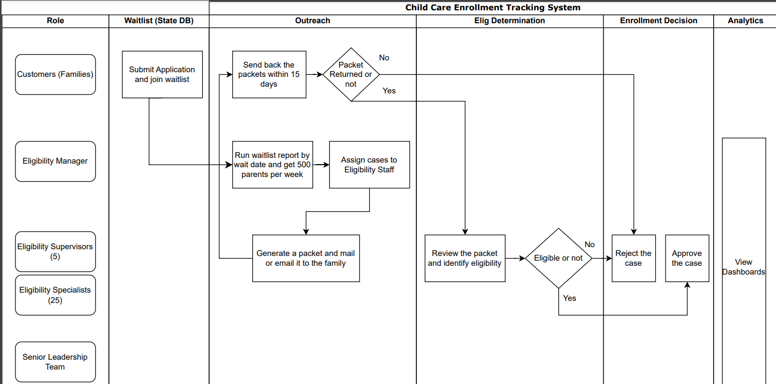
Child Care Group Enrollment Management Service
Client Workflow
Notes:
Before getting into description of our app, I first wanted to discuss the workflow of our client.

Slide 6
Child Care Group Enrollment Management Service
Client Work Flow
Notes:
First, families- customer of our client-
click
submits application for child care,
click
and the applications get saved in the State DB.
This State DB is the confidential Texas state Database, and it is something we cannot access or use in our application.

Slide 7
Child Care Group Enrollment Management Service
Client Work Flow
Notes:
The only people with the access to this state DB are
click
the Eligibility Managers, whom will be referred as managers from now on.
These managers download cases from the state db
click
and upload it to their tracking system, which has been spreadsheet so far.

Slide 8
Child Care Group Enrollment Management Service
Client Work Flow
Notes:
After cases are uploaded,
click
the staffs work on
click
generating the packets, which are paperworks that families have to fill out
click
and mail or email it to the families
After that, if the packet is returned within 15 days, the case is assigned to a staff for review. Otherwise, the case is rejected.

Slide 9
Child Care Group Enrollment Management Service
Application Flow
State DB
Manager
Client DB
User
Notes:
Now that I have described the workflow of our client, let me move on to explain how our application fit in that workflow.

Slide 10
Child Care Group Enrollment Management Service
Application Flow
Manager downloads cases data from State DB in .csv or .xlsx format.
State DB
Manager
Client DB
User
Notes:
As mentioned before, manager must download cases data from state DB in .csv or .xlsx format.
This is somewhere our app cannot interfere as the state db is confidential.

Slide 11
Child Care Group Enrollment Management Service
Application Flow
Using our app, manager uploads cases file into the Client DB
Data Validation Added
View valid/invalid data
State DB
Manager
Client DB
User
Notes:
Then, using our app, the manager can upload the file to the Client DB.
In this process, we ensure the integrity of data by checking if the input file contains any invalid data.
Only the valid data will be added to the database, and the app has feature to show which data were valid and which were not, if there are any.

Slide 12
Child Care Group Enrollment Management Service
Application Flow
Manager assigns cases to users
Cases can be updated by either assigned user or the manager
View analytics
Restrict functionalities for non-manager staffs
State DB
Manager
Client DB
User
Notes:
Now the users can use the app to interact with the data, or cases in the Client DB.
Any user can view the analytics of the cases in the homepage.
To be able to modify the cases, the user has to be either a manager or the assigned user for the case.
Also, some functionalities are restricted for non manager users.

Slide 13
Child Care Group Enrollment Management Service
Manager vs Non-Manager
Only users with Eligibility Manager role can access Manager functionalities
Users with any other roles are considered as non-manager by the app
Manager
Non-Manager
Access all cases
Upload new cases
View/Edit/Add Users
Access only assigned cases
Cannot access other user informations
Notes:
While there are various roles as shown on Client workflow page, application-wise, either the user is a manager or not.
Managers can access all cases, upload new cases, and view/modify user informations.
Non-Manager users can only modify cases assigned to them by the managers.

Slide 14
Child Care Group Enrollment Management Service
Challenges Faced
Communication
With Client: Misunderstanding regarding meeting planning with client
Within Team: Miscoordination of tasks
Changes in Requirements
While it is point of agile programming to be malleable to often changes, we did face increased workload due to rework/change features as per client feedback.
Readjustment of priority tasks
Notes:
Communication whether it was with client or with each other in team was definitely one of the challenges we faced.
We had a occasion where we had misunderstanding with our client regarding meeting time, and we ended up waiting for each other at different times.
Such frustration could have been prevented by confirming next meeting schedule at the end of each meeting.
For communication issue within team, one time, me and other teammate worked on same task due to miscoordination of the task.
It was front end design task, so we decided to present both to our client and based on the feedback, we combined both designs together.
Next, agile process was definitely some new challenge we faced. Unlike programming assignments done in classes, agile project required general goal, and constant changes in means to achieve it. That meant we often had to revisit tasks we thought was complete, or readjusting priority of tasks as per client feedbacks.
For instance, we did not consider analytics page as priority task, but we had to make it our top priority after our client told us that it is one of key feature that she expects to be completed.

Slide 15
Child Care Group Enrollment Management Service
Disclaimer: All images used in this slide are either created by us, or provided by our client.
Notes:
That is all for the presentation, and lastly all images used in this slide are either created by us, or provided by our client.
Now we will move on to the demonstration of the actual application.

